Slide 1

PHONE BOOK Individual Project Java Full Stack Developer By K . Priyanka (EBEONO62139204) Under the guidance of Shalini Kumari (Technical Trainer)
EduBridge Learning

Slide 2
CONTENTS
Why Phone Book
Aim of the project.
Software & Hardware details.
System Design
Advantages & Disadvantages.
Modules.
Output.
Future Scope
Conclusion

Slide 3
Why Phone Book
A software Phone Book is easier to use than a paper Phone Book a variety of operations can be performed easily on it.
Phone Book is thing which is useful to all users as being social entities from a child to an old man all have contacts and it provides an easy tool to manage contacts

Slide 4

AIM OF THE PROJECT
In this project, users can add a new phone record, display existing phone records, search a particular phone record and delete phone records....
As a Beginner, This simple project will teach us file handling operations such as how to add, search, list and delete records using file.

Slide 5
Software & Hardware details
Software Requirements
Platform : Java
IDE : Eclipse
Editor : Windows 10
Hardware Requirements
Intel Core
8 GB Ram
Minimum Requirements
Intel Core/AMD
256MB RAM
Hp

Slide 6
System Design
Start
Phone Book
Menu
Enter your Choice
Add Contact
Display Contacts
Search Contact
Remove
Contact
EXIT
Stop

Slide 7
Advantages & Disadvantages
It is simple for the user to store complete information (e.g. e-mail ID, address) about his or her contact.
It’s simple for the user to simply check his appropriate contact number by entering the contact number.
It is difficult to store contacts with two or more contact numbers.

Slide 8
Modules
Add Contact:
This features adds a new phone record to the file. It asks for the phone number, first name, last name and email address of the person whose record is to be created.
Display All Contacts:
In phonebook management system, this feature allows user to list all the phone records stored in file. The information displayed here are phone record number, phone number and the person’s name.

Slide 9
Search Contact:
This function is very simple, and with it users can search for a phone record by providing the phone number of a particular person whose record has already been added in the file.
Remove Contact:
This feature deletes added phone record from the file. The user needs to provided the phone number to be deleted from phonebook. It will ask confirmation message – “Do you want to remove the contact(Y/N)”,
Upon successful deletion, it displays the message – “Contact is successfully deleted!”. If the phone number provided is not found in file, the program displays the message – “Contact is not found”

Slide 10
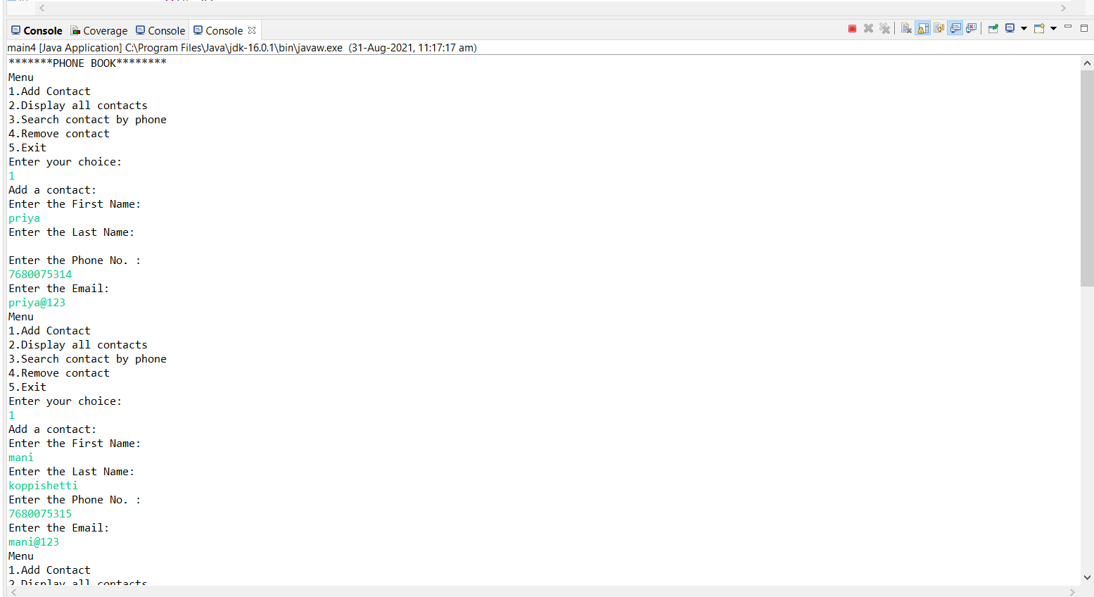
Output

Slide 11
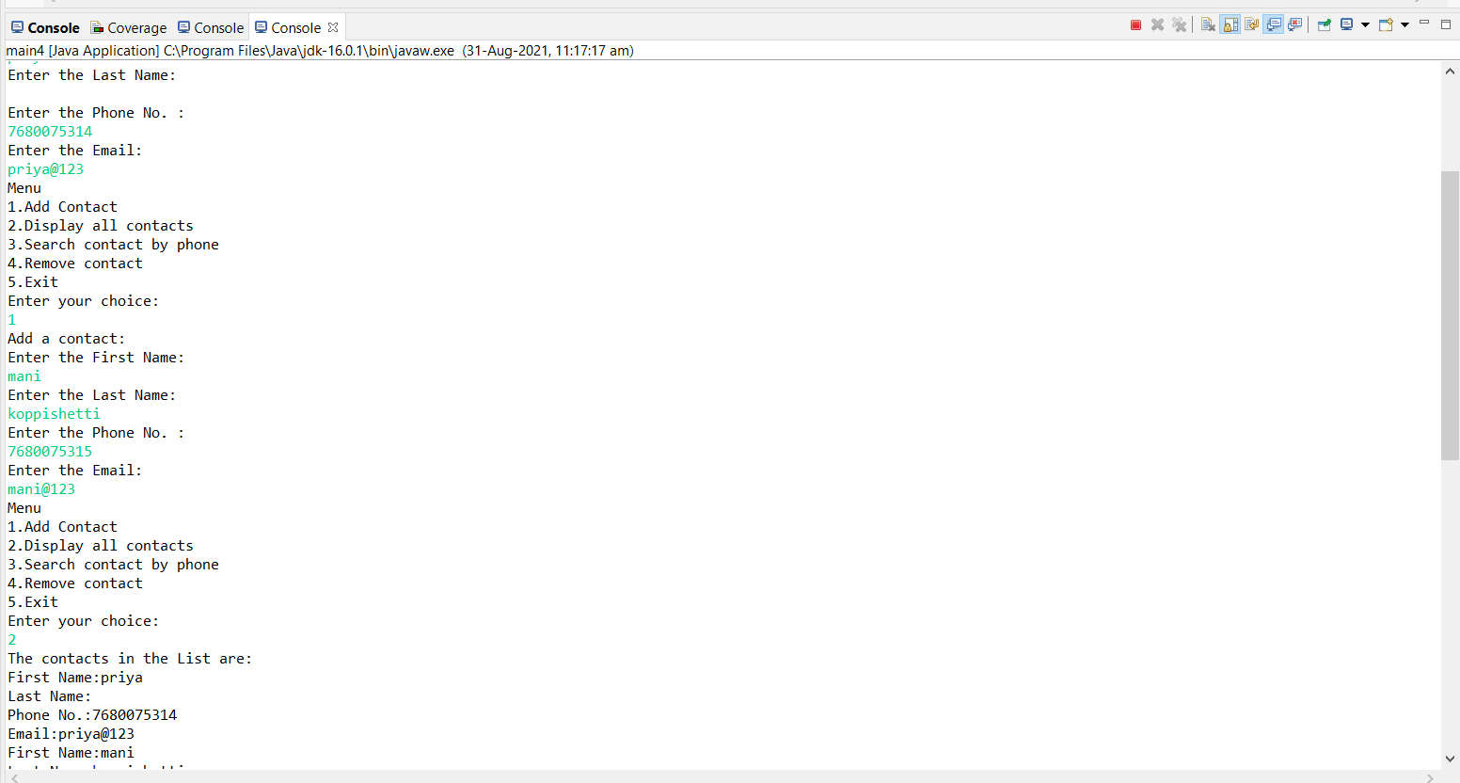

Slide 12
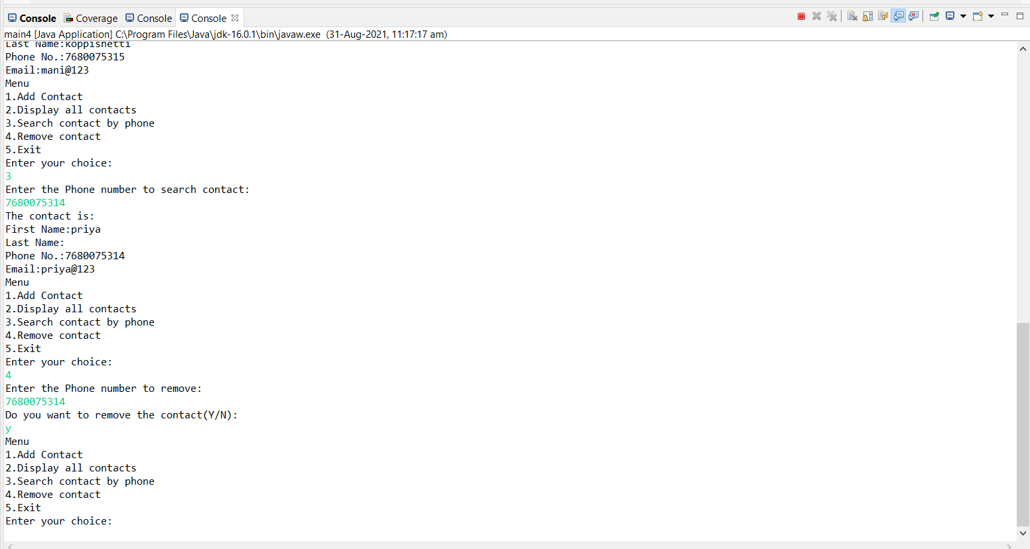

Slide 13
Future Scope
In future, we can enhance this project by adding java frameworks and SQL server too.
We can add Login password, Finger prints etc., for providing more security for user.
And one more major change which can be done in the project is that to add the snaps of the person
of which the address is entered.

Slide 14
Conclusion
This Project has been completed successfully . It is user friendly and has required options , which can be utilized by the user to perform the desired operations.
The goals that are achieved by the software are:
Optimum utilization of resources.
Efficient management of records.
Simplification of the operations.
Less processing time and getting required information.
User friendly.
Portable and flexible for further enhancement.

Slide 15


